Slide 1


Model Context Protocol USB-C for AI models
Reinier van Maanen
Consultant

Slide 2

MCP in A NUTSHELL
MCP is an open protocol that standardizes how applications provide context to LLMs, developed by Anthropic.
Think of MCP like a USB-C port for AI applications. Just as USB-C provides a standardized way to connect your devices to various peripherals and accessories, MCP provides a standardized way to connect AI models to different data sources and tools. (https://modelcontextprotocol.io/introduction)

Slide 3

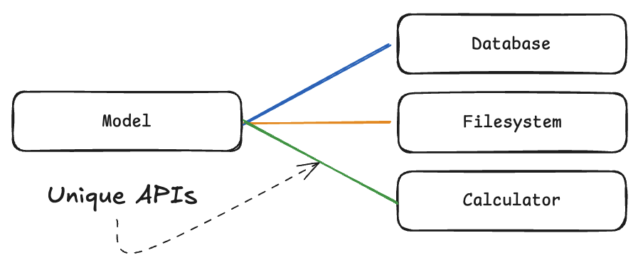
WHY
Without a protocol like MCP, developers would need to create M×N custom integrations. (https://huggingface.co/learn/mcp-course/unit1/key-concepts)

Slide 4
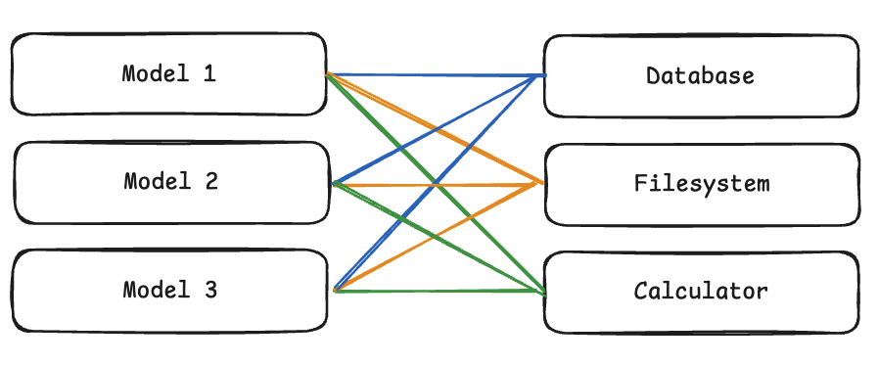
WHY
Without a protocol like MCP, developers would need to create M×N custom integrations. (https://huggingface.co/learn/mcp-course/unit1/key-concepts)

Slide 5
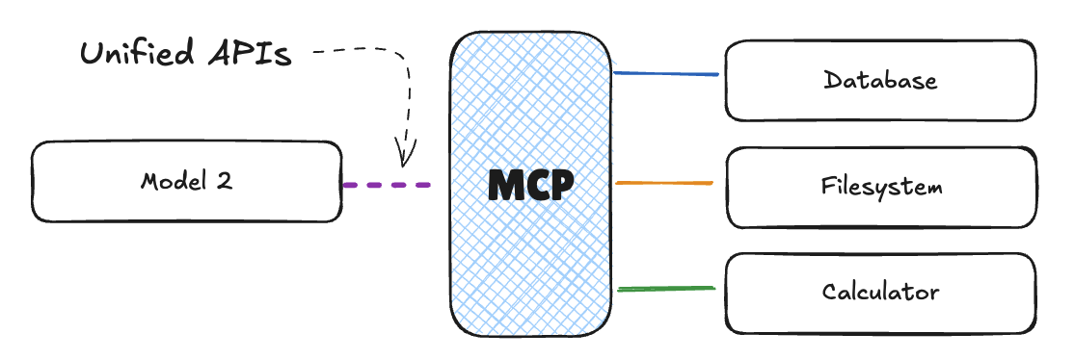

WHY
MCP transforms this into an M+N problem by providing a standard interface. (https://huggingface.co/learn/mcp-course/unit1/key-concepts)

Slide 6

Architecture
YOUR COMPUTER
INTERNET
HOST
MCP CLIENT
MCP SERVER
TOOLS/RESOURCES/PROMPTS
MCP CLIENT
MCP SERVER
TOOLS/RESOURCES/PROMPTS
MCP CLIENT
MCP SERVER
TOOLS/RESOURCES/PROMPTS

Slide 7
Architecture
YOUR COMPUTER
INTERNET
JSON-RPC
HOST
MCP CLIENT
1:1
MCP SERVER
TOOLS/RESOURCES/PROMPTS
MCP CLIENT
MCP SERVER
TOOLS/RESOURCES/PROMPTS
MCP CLIENT
MCP SERVER
TOOLS/RESOURCES/PROMPTS
HTTP or STDIO

Slide 8
Architecture
YOUR COMPUTER
INTERNET
VS CODE
HTTP CLIENT
DOCKER CONTAINER
FILESYSTEM
HTTP CLIENT
DOCKER CONTAINER
DATABASE
STDIO CLIENT
PYTHON SCRIPT
WEB API

Slide 9
LATEST DEVELOPMENTS
YOUR COMPUTER
INTERNET
OAuth instead of PAT
VS CODE
MCP CLIENT
REMOTE MCP SERVER
TOOLS/RESOURCES/PROMPTS
More details:
https://modelcontextprotocol.io/docs/concepts/architecture
https://code.visualstudio.com/blogs/2025/06/12/full-mcp-spec-support

Slide 10

THINGS TO KNOW
Supported by IDEs like Visual Studio (Code), Claude Desktop, Rider and more
Often in preview!
You do not need to built your own, there are thousands already (https://mcpservers.org/, https://github.com/modelcontextprotocol/servers )
You can build your own
Be careful..

Slide 11
THE S in MCP STANDS FOR SECURITY
Emerging threat vectors identified by Microsoft
Cross-Prompt Injection: Malicious content embedded in UI elements or documents can override agent instructions, leading to unintended actions like data exfiltration or malware installation.
Authentication Gaps: MCP’s current standards for authentication are new and inconsistently adopted. OAuth is optional, and ad-hoc approaches are emerging.
Credential Leakage: Agents running with full user privileges risk exposing sensitive tokens or credentials.
Tool Poisoning: Unvetted or low-quality MCP servers may expose dangerous functionality or be used to escalate privileges
(https://blogs.windows.com/windowsexperience/2025/05/19/securing-the-model-context-protocol-building-a-safer-agentic-future-on-windows)

Slide 12
THE S in MCP STANDS FOR SECURITY
Emerging threat vectors identified by Microsoft
Lack of Containment: Without isolation, a compromised agent can affect the entire user session or system.
Limited Security Review: Many servers are rapidly developed with minimal security review, increasing the risk of vulnerabilities.
Registry and MCP Supply Chain Risks: Without vetting, a public registry of MCP servers could become a vector for malware or abuse.
Command Injection: Improperly validated inputs in the MCP server can lead to arbitrary command execution.
(https://blogs.windows.com/windowsexperience/2025/05/19/securing-the-model-context-protocol-building-a-safer-agentic-future-on-windows)

Slide 13
THE S in MCP STANDS FOR SECURITY
MCP draft protocol change: Authorization with OAuth
Authorization is still OPTIONAL for MCP implementations (https://modelcontextprotocol.io/specification/draft/basic/authorization)
Auth0 is collaborating with Cloudflare to make it easier for developers building remote MCP servers to configure authentication and authorization (https://auth0.com/blog/secure-and-deploy-remote-mcp-servers-with-auth0-and-cloudflare/)
Many servers already support OAuth, like the GitHub MCP server in the labs
If you must use a PAT, limit its scope
Check MCP servers before using, like any other public tools or code

Slide 14
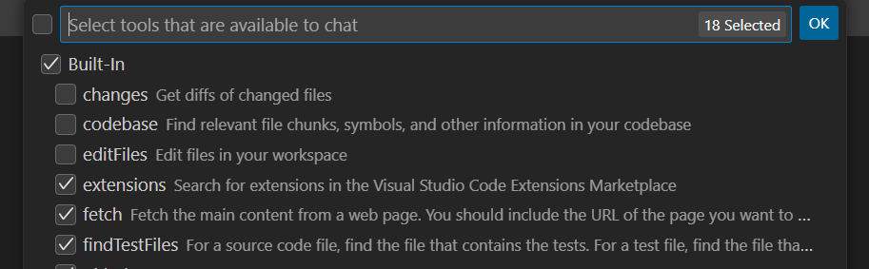
THE s also stands for stability ;)
It’s early days
MCP servers itself contain bugs
Tooling support is a work in progress
Sometimes a model just gives an answer without using MCP
Try directing it with a system prompt
VS Code: Make sure you run in agent mode
VS Code: Check if the tools are not disabled

Slide 15
OTHER THINGS TO know
VS code supports prompt files as experimental feature
Prompt files are reusable prompts for common tasks
Scoped to your workspace or VS code profile.
Prompt files have a tools section which indicate which MCP tools can be used
Not part of the workshop, but good to have a look at afterwards
See https://code.visualstudio.com/docs/copilot/copilot-customization#_prompt-files-experimental

Slide 16

NO DEMO
HANDS-ON TIME

Slide 17

What TO DO
https://github.com/xebia/integrate-mcp-with-copilot
Press copy exercise and follow the instructions
These slides are also present in the repository
While waiting for the codespace to be created, have a look at existing MCP servers

Slide 18
NO DEMO, HANDS-ON!

Slide 19
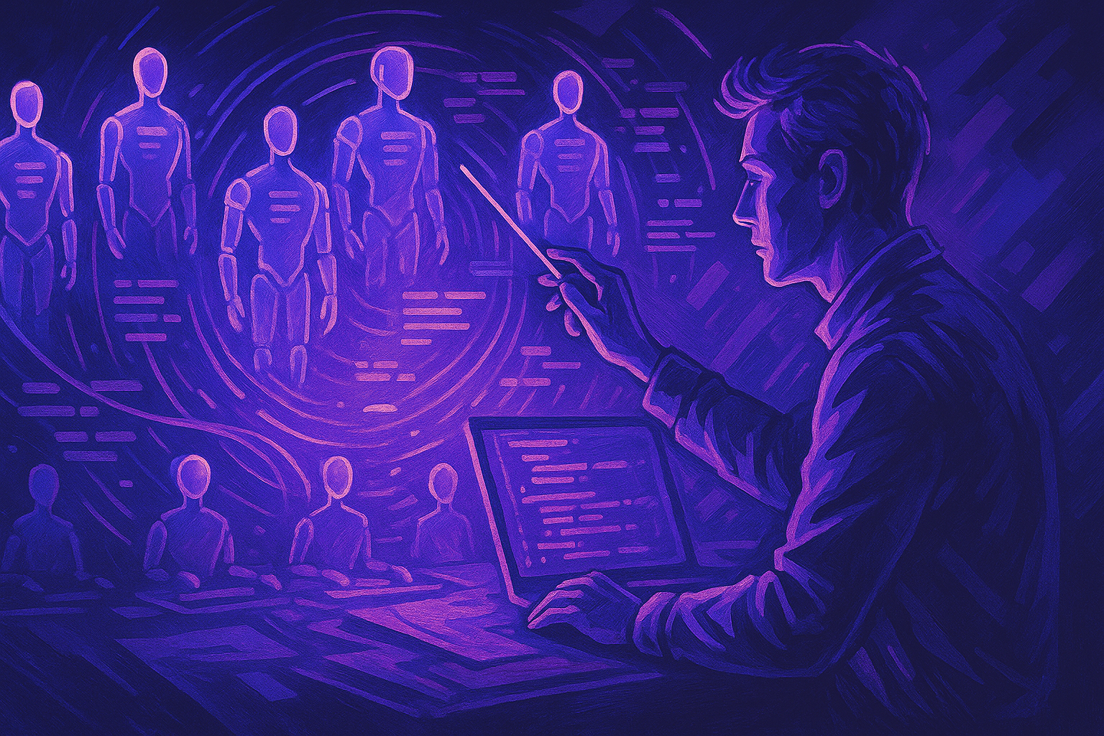
What will be the new role of a developer in the time of AI?

Slide 23


Slide 24


